Slide 1
AVIATION SAFETY RISK ANALYSIS
Identifying lower-risk aircrafts to support acquisition decisions
Prepared for: head of aviation division
By: Eve michelle
Date: 15th December 2025

Slide 2
1.Business Problem and Objective
The company is expanding into the aviation industry and must make informed aircraft acquisition decisions.
Aviation accidents present significant safety, financial, and reputational risks.
Leadership currently lacks historical insight into which aircraft manufacturers and models are associated with lower operational risk.
This analysis uses historical aviation accident data to support safer, data-driven aircraft purchasing decisions.

Slide 3
2.Data and Analytical Approach
Historical aviation accident and incident data sourced from the National Transportation Safety Board (1962–2023).
Each record represents a reported aviation event, including aircraft information and injury outcomes.
Data was cleaned and filtered to focus on aircraft manufacturers and injury severity.
Risk was assessed using injury severity metrics rather than accident frequency alone.
Findings were supported using aggregated analysis and visual exploration.

Slide 4
3. Key Safety Insights from Historical Data
Aviation safety risks vary significantly across aircraft manufacturers.
Injury severity provides a more meaningful measure of risk than accident frequency alone.
Some manufacturers are consistently associated with lower average injury counts per accident.
High accident counts do not always correspond to higher injury severity.
Below are examples of visualizations.

Slide 5
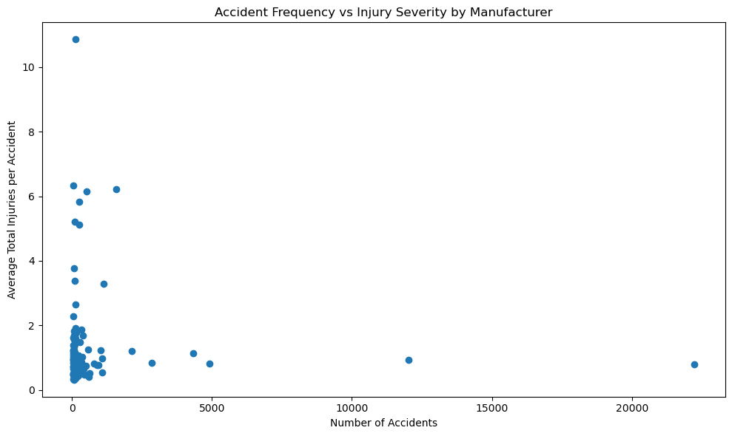
Accident frequency vs. injury severity

Slide 6
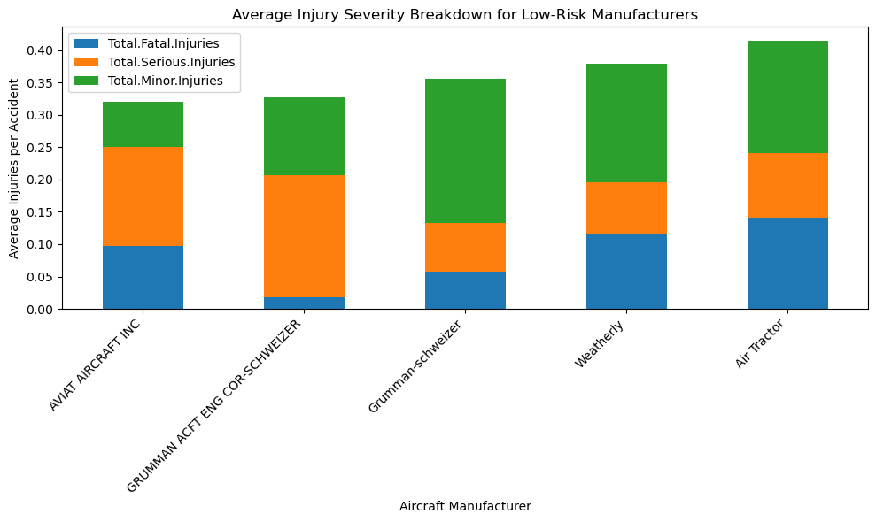
Average Injury Severity Breakdown for Low-Risk Manufacturers.

Slide 7
4. Reccomendations
Recommendation 1: Prioritize Lower-Risk Aircraft Manufacturers
Historical accident data shows that some aircraft manufacturers are consistently associated with lower average injury severity.
Aircraft acquisitions should prioritize manufacturers with lower injury outcomes per accident.
This approach reduces exposure to safety, legal, and reputational risk.
Business Impact
Lower injury severity reduces operational risk, insurance costs, and potential reputational damage.

Slide 8
Recommendation 2: Avoid Decisions Based Solely on Accident Frequency
Some aircraft manufacturers appear frequently in accident records due to higher usage, not poorer safety performance.
Accident counts alone can be misleading when evaluating aircraft risk.
Aircraft selection decisions should focus on injury severity metrics rather than raw accident frequency.
Business Impact:
Prevents the exclusion of widely used but relatively safe aircraft and supports more accurate risk assessment.

Slide 9
Recommendation 3: Use Injury Severity as a Core Safety Metric
Accident frequency alone does not provide a complete picture of aircraft safety risk.
Injury severity offers a more meaningful and actionable measure of operational risk.
Future aircraft evaluations should incorporate injury severity metrics alongside cost, performance, and operational needs.
Business Impact:
Enables consistent, data-driven safety assessments and supports safer long-term aircraft procurement decisions.

Slide 10
5. Interactive Dashboard for Further Exploration
An interactive Tableau dashboard was created to allow stakeholders to explore aviation safety risk in greater detail.
Users can examine injury severity, accident trends, and manufacturer-level risk interactively.
The dashboard enables flexible exploration to support ongoing decision-making.
View the dashboard on Tableau Public:
https://public.tableau.com/app/profile/eve.michelle/viz/AviationSafetyRiskAnalysis/Dashboard1?publish=yes

Slide 11
6.Conclusion
Aviation safety risks varies meaningfully across aircraft manufacturers.
Injury severity is a more reliable indicator of operational risk than accident frequency alone.
Data-driven evaluation can reduce safety, financial, and reputational exposure as the company enters the aviation market.

Slide 12
7.THANK YOU
Questions & Discussion

